Slide 1
Living on the Edge - How 5G is going to enable the Medical Internet of Things big time
Professor Christoph Thuemmler, MD, PhD
Edinburgh Napier University

Slide 2
Myth Busters
More and less likely relevant 5G application scenarios in the health and care domains

Slide 3
Surgical Robots

Slide 4
Social Robots

Slide 5
XaaS OTT
Problems:
Privacy
vendor lock-in legislation
security
trust…
Diabetes
Asthma / COPD
Other chronic conditions
IBM Watson,
Google,
Microsoft
Consumer
fixed / mobile
Service Provider
XaaS OTT

Slide 6
Ambulance Services
Scoop and run vs stay and play

Slide 7
5g killer apps in health and care
IIOT and NB-IOT

Slide 8
Smart Pharmaceuticals, Population Health Management, Precision Medicine
Asthma around 334 million people (Global asthma report 2014)
COPD: 384 million people in 2010 https://www.ncbi.nlm.nih.gov/pmc/articles/PMC4693508/
Diabetes: around 420 million people (WHO 2014)
Plus Cancer, Mental Health, Dementia, MS
NB-IOT to replace Bluetooth as enabler of smart pharmaceuticals

Slide 10
New 3M Inhaler, market release around 2019

Slide 11
Driver Condition Monitoring
Autonomous driving will require the presence of a fit driver
Regulators are likely to require monitoring in order to proof fitness
Captured health data have different privacy requirements from technical data
Health data is a valuable commodity but will require data owner authorization for processing
Multi-provider orchestration will be required to create more valuable individual health information (which might even replace routine check-ups to a certain extend)

Slide 12
Hospital @ Home
Clear shift from hospital care to hospital at home
More devices will be deployed into the home environment
Device monitoring will be required to manage maintenance, QoS, QoE and governance in an environment which will not be monitored by a nurse on a regular basis
NFV might be instrumental in the future to shift virtualised functions (settings of infusion pumps, monitoring devices, etc) between clouds (hospital to home)
NB-IOT to enable device status monitoring

Slide 13
Local Policy implementation, Teaching, Training, Research
National
Public
Personal Devices, Smart Phones, Private Clouds, APIs
National Digital Health Policy 2017 – 2022, Specification, eHealth Legislation, Governance
Global security Policy, Standards, Net Neutrality (GDPR, ISO 80001, ISO 27000 etc)
Local provider eHealth nodes, Fog, local clouds, Governance
Network Operators, Service Providers (Population Health Management, OTT services, Smart Health, etc) SDN, NFV
National Physical / logical Infrastructure, National Grid
5G Infrastructure, Core Network, Orchestration
Social-Technological Alignment, National / Global eHealth Grid 2020

Slide 14
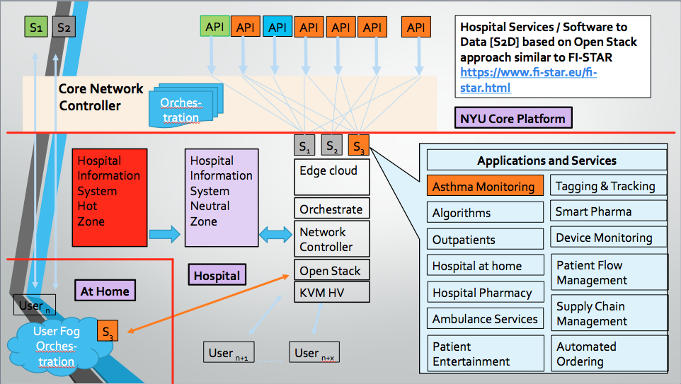

Slide 15
Multi Edge Cloud and Private 5G network supporting arguments
Multi Edge Cloud / Private 5G Networks like to pick up in health due to value of the business (in China around 6% of GDP, Europe 10% of GDP, in the US 18.5% of GDP)
Healthcare providers, pharmaceutical industry and policy makers unlikely to leave such a relevant industry to digital service providers such as IBM, Google or Microsoft to develop OTT XaaS business model (especially outside the US)
General Data Protection Regulations
Parallel processing and distributed computing are extremely strong trends
Managing local problems locally might safe energy, bandwidth and cost, especially as global 5G coverage is unlikely to happen within 25 years from now

Slide 16
Outlook
Current trends and activities in the eHealth domain which will boost the implementation / deployment of 5G

Slide 17
Open Multi Access Edge-Cloud [OMEC]
OMEC discussion during 5G Roadmap meeting in Paris on 25.May 2017

Slide 18
WWRF 5G eHealth Action
Current WWRF White Paper (living document) on eHealth, http://www.wwrf.ch/files/wwrf/content/files/publications/outlook/Outlook17.pdf
WWRF eHealth 5G Proof of Concept focusing on asthma, COPD and MS likely to commence in July 2017. Testbeds in UK, Greece, China and potentially in the US
Funders Huawei, Intel, potentially others
Partners welcome!

