Slide 1
Panel Session:
5G Test and Measurement
IEEE 5G Summit
Malcolm Robertson, Keysight
Jon Martens, Anritsu
Chris Scholz, Rohde & Schwarz
Jason White, National Instruments
Moderator: Kate A. Remley, NIST

Slide 2
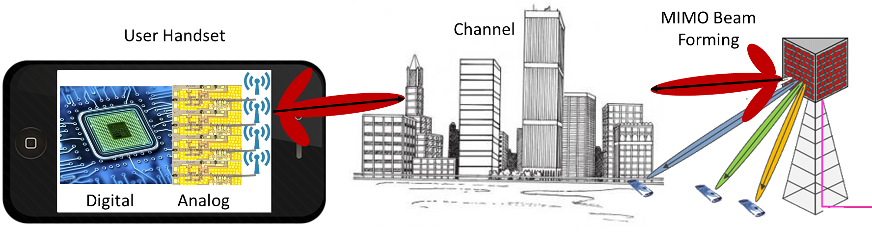
So Many Systems,
So Much to Measure
mmWave Transistor and NL-Device Measurements
mmWave Signal Characterization
Channel Measurement and Modeling
Massive MIMO and Over-the-Air Test

Slide 3
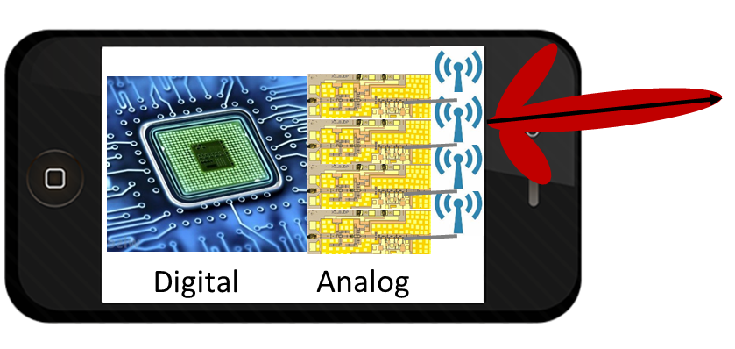
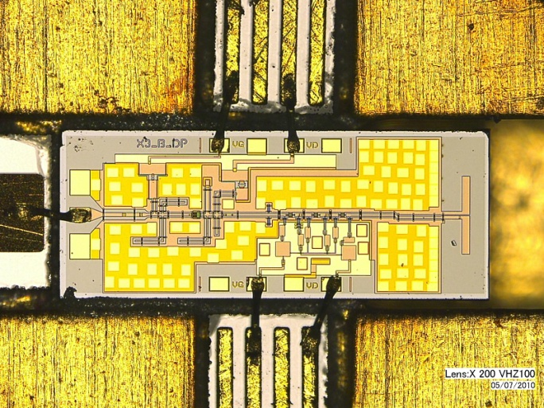
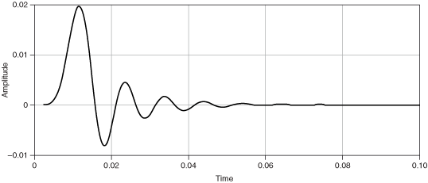
Some Measurement Challenges
Millimeter-wave Transistor and NL-Device Measurements
mmWave Transistor Measurements and Models
Acoustic-Wave Filters
New Materials
Millimeter-Wave Signal Characterization
Waveform Traceability
Source and Transmitter Characterization
Impedance, Power, Noise
Uncertainty and Demodulation Errors

Slide 4

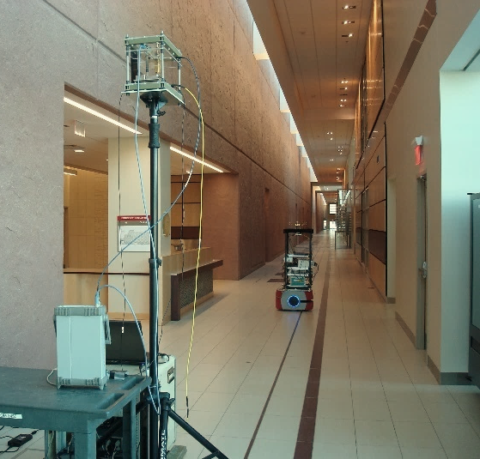
Channel Measurement Challenges
Channel
Indoor 83 GHz channel measurements
Channel Measurement and Modeling
Channel Sounding: Indoor and Outdoor
Channel Modeling and Standards
Effect of Uncertainty on Metrics, Models
Angle of Departure, Angle of Arrival
Many bands: 28, 38, 60, 72, 83 GHz, …
PDPs for a single location, different orientations

Slide 5
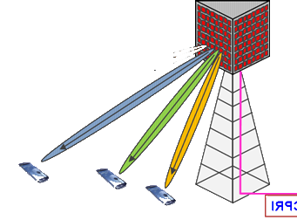
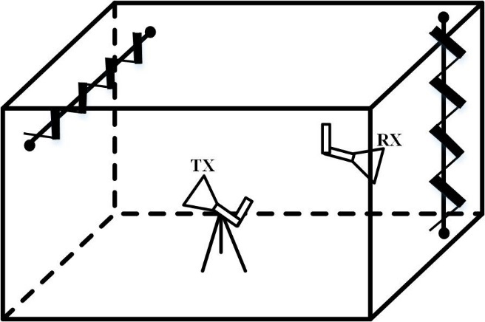
Antenna Measurement Challenges
MIMO Beam Forming and Over-the-Air Test
OTA test at mmWave in reverberation chamber
Antenna measurement over multiple angles
OTA Test and Massive MIMO
Wideband Antenna Calibrations
MIMO Antenna Test
Free-Field Modulated Signal Test
Reverberation-Chamber Methods
Beam Forming
Smart Path Beam Forming Based on Antenna and Channel Models
Testing Beam-Forming Algorithms

Slide 6

The Measurement Elephant in the Room
On-Wafer to OTA – No connectors to test:
  Efficiency
  Distortion
  Troubleshooting stages
What is the answer??

Slide 7
Some Questions for Discussion
Devices and Materials:
  What are prospects for large-signal network analysis at mmWave frequencies?
  What are issues tuning mmWave harmonics?
  What is the role of materials measurements in future wireless?
Signal characterization:
  How to handle issues with cascading non-ideal, distortion-inducing instruments (similar to Additive EVM)?
  How do you see the role of traceability in waveform measurements?
Channel measurements:
  Why is it more important to decouple the antenna from the channel measurement?
  Will errors in channel sounders be more important at mmWave frequencies?
Antennas and Massive MIMO:
  How does one generate a known test field for multiple-element antenna arrays?
  What is the role of statistics in testing arrays that operate in more states than you can count?
  What are issues with distributed array timing and synchronization?
The Elephant in the Room:
  How to merge on-wafer and OTA test to verify performance?

Slide 8

Test and Measurement in 5G – A Global Inflection
^{Malcolm Robertson}

Slide 9
5G Technology Trends
Exploding Data Growth
Complex 5G Technologies
Evolution of the RAN
Accelerated Timelines

Slide 10
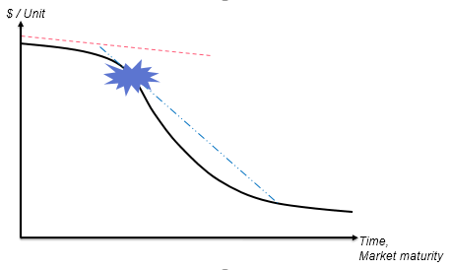
5G Economic Trends
Falling Wireless Industry CAPEX
Cost of Test Driven Down
Intense Competition
Cloud Economics

Slide 11
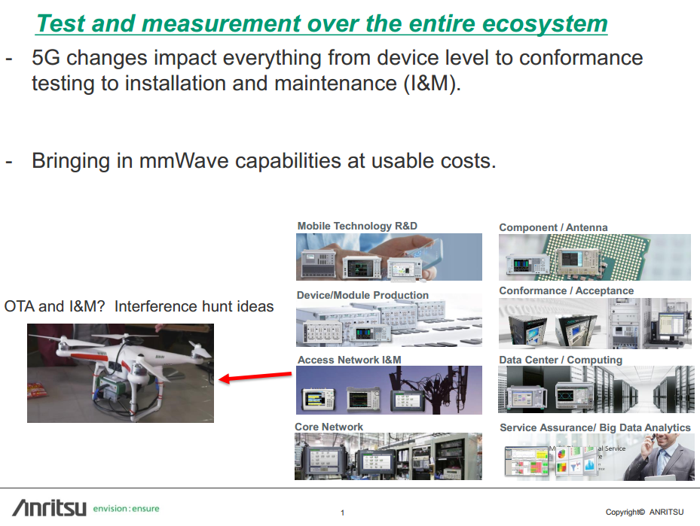

Slide 12
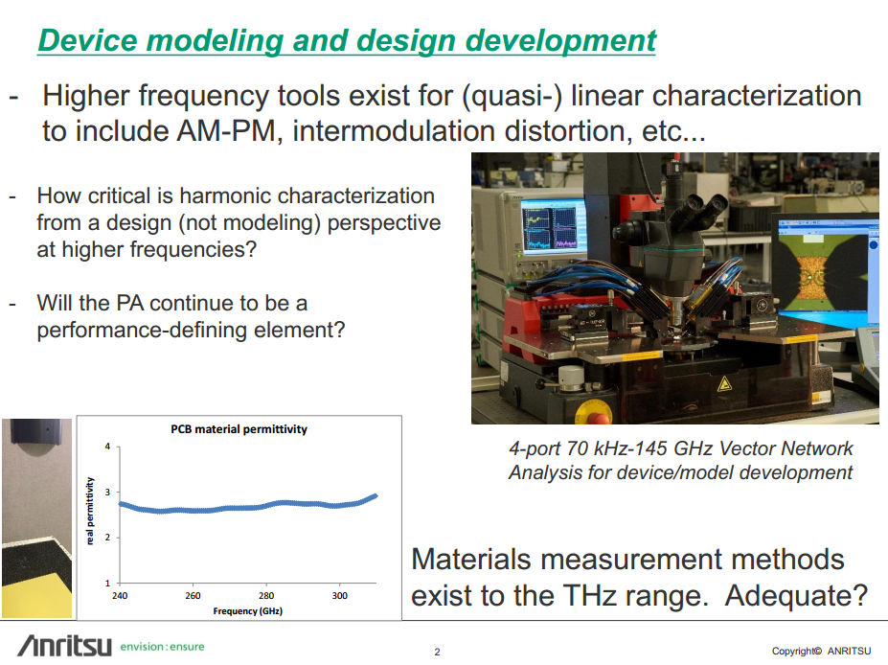

Slide 13
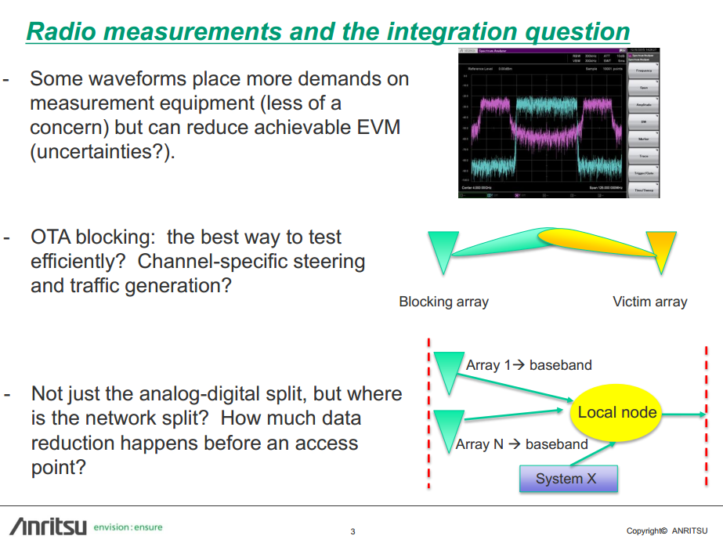

Slide 14
5G Test and Measurement Challenges
IMS2017 5G Summit
Chris Scholz
Product Manager, Vector Network Analyzers
Rohde & Schwarz North America
Chris.scholz@rsa.rohde-schwarz.com
(817) 422-2512
Rohde & Schwarz North America

Slide 15
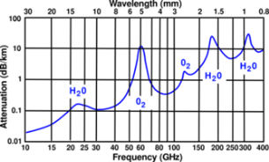
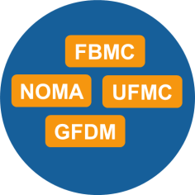
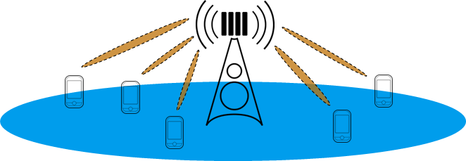
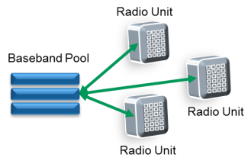
Impact of 5G on Test & Measurement
mm-Wave Frequencies
- cm-Wave and mm-Wave frequency bands, wider bandwidths
- New channel models reflecting different propagation conditions
New air interface technology/New protocols
- Multiple air interface candidates analyzed in research
- Obvious impact to the complete test portfolio
Massive MIMO/mm-wave MIMO
- Significantly increased number of Tx/Rx elements
- Over the air measurements become essential
Cloud based network architecture
- Centralized base station baseband with high number of distributed radio units ideally connected with no latency (fiber); SDN and NFV
- Traffic analytics and security will gain importance

Slide 16
5G Impact on Components Testing
4G Components/Devices
5G Components/Devices
Conventional Solution
  Multiple discrete components
  Designed/verified as component
  Easy to Test
Majority of Cost in Precision Metal
  Antenna
  Diplexer
  Waveguide Elements
  Transitions/Interconnections
Single Chip CMOS
  RF/ADC/DAC/Modem
Large part of cost is in Test
  mmW test in production
  Wafer-level functional test
Cost
  Test equipment
  Accuracy/Repeatability/Traceability
  Ease of use
  Time of test
Antenna
mmW Antenna
RF
RF
ADC/DAC
MODEM
ADC/DAC
MODEM
Controller
Controller

Slide 17


5G Measurement Issues in Brief
2017 International Microwave Symposium, June 2017
Jason White
Director, RF and Wireless Test
National Instruments
ni.com/5g
ni.com

Slide 18

Key Test Challenges for 5G
Multi-Standard
Coverage
Ultra-wide Bandwidths, Multiple Carriers / Beams
Antenna
Arrays
Total Cost
of Test
4G: 200 MHz
28 GHz
39 GHz
70 & 90 GHz
4.5 G: 640 MHz
5G: 800 MHz
(Phase 1)
37 GHz
60 GHz
5G: 2 GHz (Phase 2)
Channel Scaling
for MIMO / CA
Port
Mobility
OTA Calibration
and Control
Calibrated Air Interfaces
and Chambers
…
Signal-to-Noise Ratio
Phase
Noise
+18 dBm ± 0.5 dB
– 50 dB
– 32 dBm ± 0.5 dB
2 – 128 MIMO channels
Near field / Far Field
ni.com/5g
Notes:
But first let’s review the major challenges that we face from a test perspective when operating at mmWave frequencies. To summarize, we require [read list], which is a very tall order and one that clearly won’t be feasible with current test architectures and testing approaches.
Operation at cm/mmWave requires:
Flexible frequency coverage for a wide range of regional and domestic frequency bands, and standards (e.g. 802.11ad WiFi @ 60 GHz)
Wide bandwidth signal generation and acquisition
Excellent noise performance
Scalable channel counts
Port mobility to accommodate beamforming test and to maximize performance
Over-the-air measurement capability with calibrated measurements to the plane of the DUT

Slide 19
NI’s Architectural Approach to 5G Test Challenges
Modularity
Frequency and
Channel Agility
Software-defined
Signal Processing
Add performance as future requirements emerge
Integrate non-RF I/O into same system to maintain small footprint
Flexible mmWave configurations for multi-DUT, multi-frequency and beamforming test
Tight timing and synchronization for MIMO configurations
Accelerated measurements using real-time FPGA processors programmed
with LabVIEW FPGA
Achieve demanding
EVM requirements through more sophisticated calibration techniques
Key Open Issues for Test:
Test cost of millimeter wave and MIMO
Over the air access / control
ni.com/5g
Notes:
Well, from our perspective, the test systems will look something like the following and be architected with three design themes in mind.
First, they will be built with an intense focus on signal processing power and flexibility. With the ability to leverage real time signal processing for both higher layer, real-time test, as well as acceleration of parametric measurements, FPGAs and other high performance processing units will play a key role in the next generation mmWave test systems.
The second principle is modularity. There is massive value in being able to scale port counts, add channels with picosecond level synchronization for MIMO, add non-RF I/O and scale the performance of key functional blocks like ADCs and DACs as new technology emerges.
Finally, the last principle focuses in purpose built port extensions that target the specific frequencies of interest instead of providing full frequency coverage from DC to light. This method delivers higher performance, smaller size, mobility in placement all at a lower cost.

Slide 20
ni.com/5g

